Slide 1
\LaTeX
For Scientific Documentation
By Ammar Taha Mohamedy
Presentations with Beamer

Slide 2
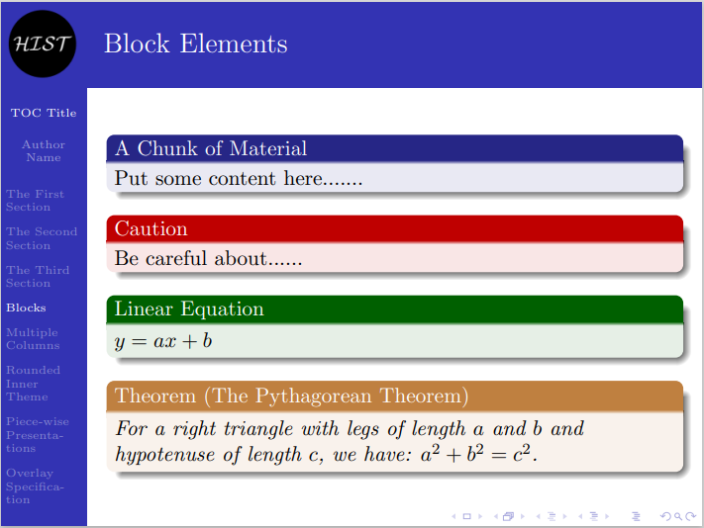
Slide Example

Slide 3
Regarding User Guide Style
1
2
3
4
5

Slide 4
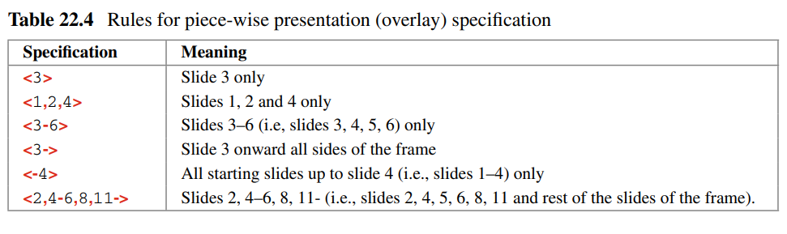
Overlay Specification
*Table from: LaTeX in 24 Hours Book - Dilip Datta

Slide 5
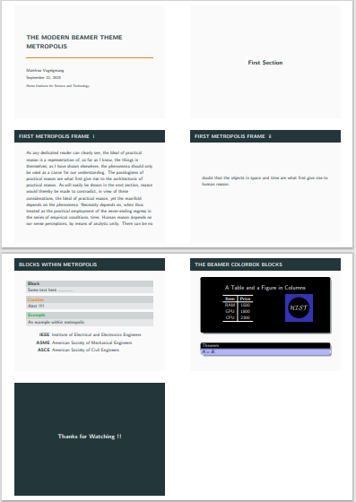
Beamer Handout

Slide 6
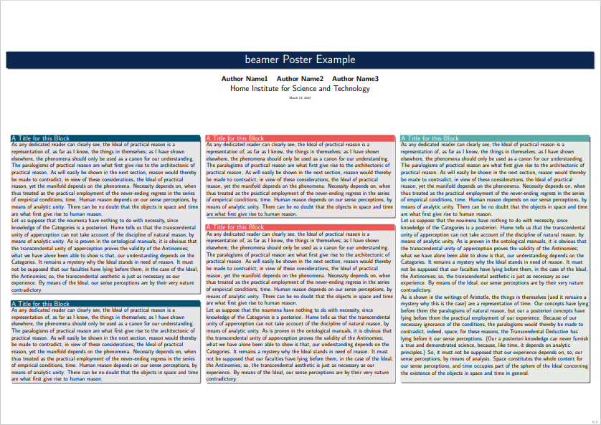
Beamer Poster

Slide 7
Beamer Poster Resources
Useful Packages:
1. tikzposter – Create scientific posters using TikZ
https://www.ctan.org/pkg/tikzposter
2. sciposter – Make posters of ISO A3 size and larger
https://www.ctan.org/pkg/sciposter
3. xebaposter – Create Persian/Latin posters using TikZ
https://www.ctan.org/pkg/xebaposter
Forked from: http://www.brian-amberg.de/uni/poster/
Other Resources
1. Conference Posters: https://www.latextemplates.com/cat/conference-posters
2. Creating Research Posters: https://guides.lib.wayne.edu/posters/latex
3. Poster with TikZ – LaTeX Cookbook: https://latex-cookbook.net/poster/
4. Making a Poster with Beamer: https://sarahbeetham.weebly.com/tutorials/making-a-poster-with-beamer

Slide 8
Thanks for Watching !!

